Slide 1

ONLINE RENTAL HOUSE
K. ANUKAVIYA
III BSC COMPUTER SCIENCE
Guided by KOKHILA MAM

Slide 2

ABSTRACT
This Web Application helps user to register individual home or apartment to assist you in finding the perfect rental home or property. Also, we can find your next rental from search view in your targeted area. This website is designed to attend to all our needs from buying property, selling property in India. Here we found the better opportunity to invest our value of entire life. Property helps us to maintain the database of various property & agents’ information. It not only helps us to maintain the agent information but here we also allow agents to access the portal updated information across the global environment. We know it is a trying to call individual property agents, arrange appointment, finding better time for appointment and they will assist you. For such complex process we provide a one simple online form which requires your basic information and we will assist in sort time period.

Slide 3

OBJECTIVES
Customer can know about property details
Customer can book the property arrange appointments ,can call property agents
Can track buyers detail

Slide 4
HARDWARE SPECFICATION
Processor : P 4 700 GHz.
RAM : 4 GB RAM
Hard Disk Drive : 180 GB

Slide 5
SOFTWARE SPECIFICATION
Operating System : Windows 7/8/10
Front End : JAVA
Back End : SQL

Slide 6

EXISTING SYSTEM
Manual process
More brokerage for search houses
Everyone not comfortable for this

Slide 7

PRAPOSED SYSTEM
Systematic
Everyone can registration and visit the page
All type of properties shown in the page
As per our requirements we can choose

Slide 8
MODULES
User Registration
When the user needs to search home or apartment they should need to register and login to the application. Once the user has been registered with username and password, they can able to login. If the user enter the correct details only they can able to login and buying or selling house.
Add Houses
The main role of admin can register the house and house details. When the admin updating the house details in the portal it will be showing in the user account.

Slide 9
Houses Details
The registered houses are showing in the home page, after login user can view the page, admin also can be modified the house details as well. Once the house has been booked, we don’t show to the other users.
Booking House
If user wants to book the house, the user can book the house via this application. Once the user books the house the admin will get notify and reach the customer and discuss the details about the house.

Slide 10
Data flow diagram:
LEVEL:0
ONLINE RENTAL
HOUSE
ADMIN
username
username
USER
password
password

Slide 11
Level 1:
Add house
ADMIN
HOUSE DETAILS
CUSTOMER
DETAILS
view booking
house
Customer
registration
Booking
house
CUSTOMER
BOOCKED HOUSE DETAILS

Slide 12
TABLE NAME: ADMIN
FIELD | DATA TYPE | SIZE | CONSTRAINT
Admin id | Int | 10 | Primary key
Username | Varchar | 30 | Not null
password | Varchar | 30 | Not null

Slide 13
TABLE NAME: HOUSE
FIELD | DATA TYPE | SIZE | CONSTRAINT
house id | Int | 10 | Primary key
House name | Varchar | 20 | Not null
Owner name | Varchar | 20 | Not null
Contact number | Int | 10 | Not null
Address 1 | Varchar | 30 | Not null
Address 2 | Varchar | 30 | Not null
Area name | Varchar | 30 | Not null
City name | Varchar | 20 | Not null
District name | Varchar | 30 | Not null
State name | Varchar | 10 | Not null
Land mark | Varchar | 20 | Not null
Pin code | Varchar | 6 | Not null
Total square fit | Varchar | 5 | Not null
Bed room | Int | 5 | Not null
Hall | Int | 5 | Not null
Kitchen | Int | 5 | Not null
Others | Varchar | 20 | Not null
Price details | Int | 5 | Not null

Slide 14
TABLE NAME: CUSTOMER
FIELD | DATA TYPE | SIZE | CONSTRAINT
Customer id | Int | 10 | Primary key
Customer name | Varchar | 20 | Not null
Mobile | Int | 10 | Not null
Email | Varchar | 20 | Not null
Username | Varchar | 20 | Not null
Password | Varchar | 20 | Not null

Slide 15
TABLE NAME: BOOKING
FIELD | DATA TYPE | SIZE | CONSTRAINT
Booking id | Int | 10 | Primary key
Customer id | Int | 10 | Foreign key
House id | Int | 10 | Foreign key
Booking status | Varchar | 20 | Not null

Slide 16
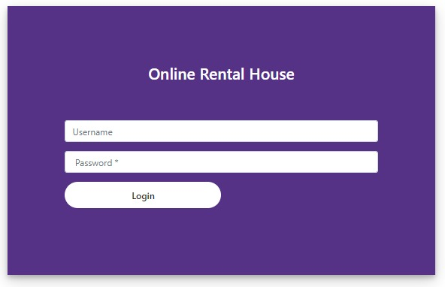
FORM DESIGN

Slide 17
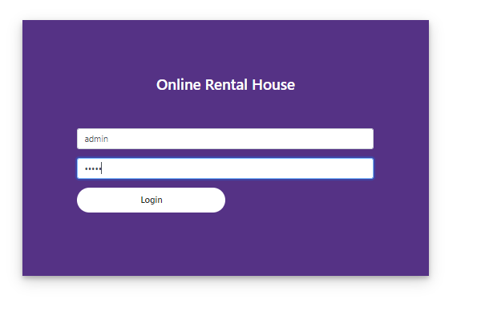

Slide 18
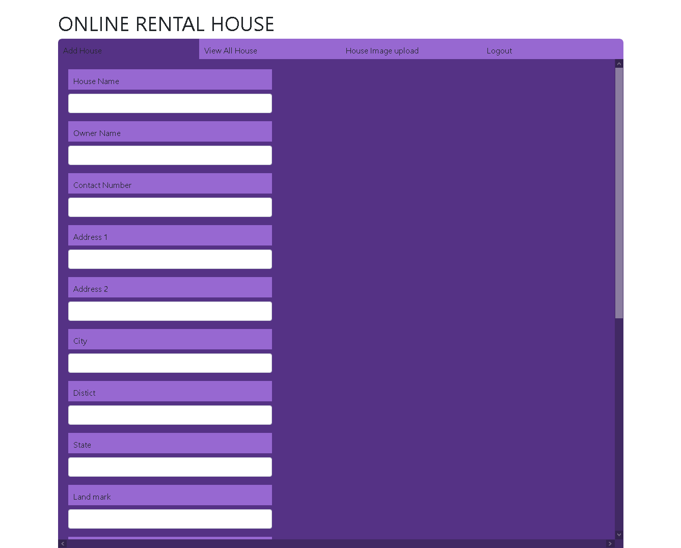

Slide 19
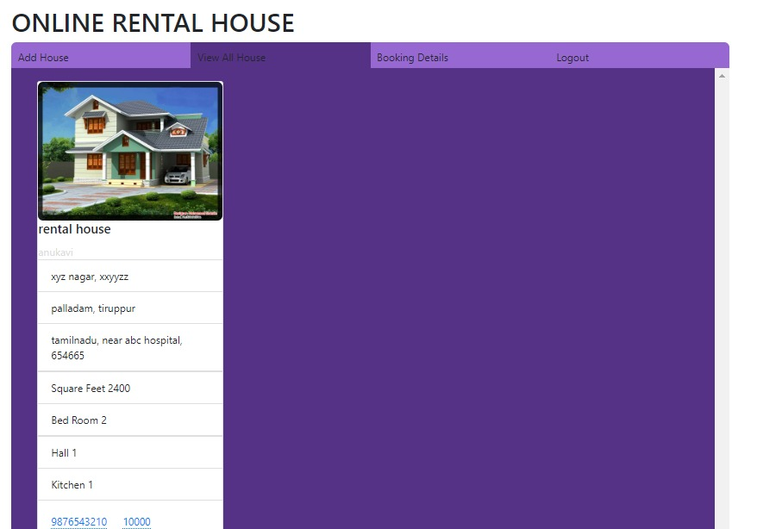

Slide 20
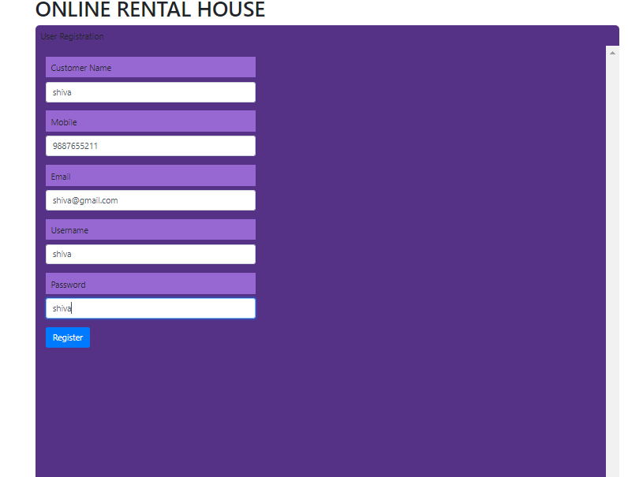
User registraion
http://localhost/2023/Online%20Rental%20House%20(1)/Online%20Rental%20House/Front/user-registration.html

Slide 21
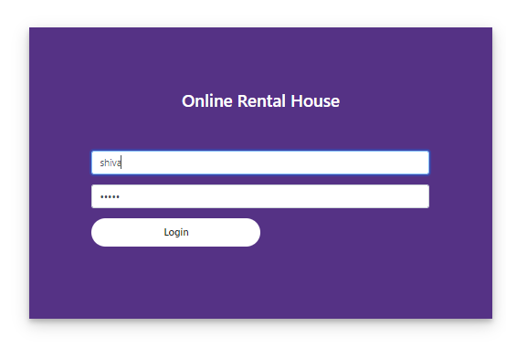
User login

Slide 22
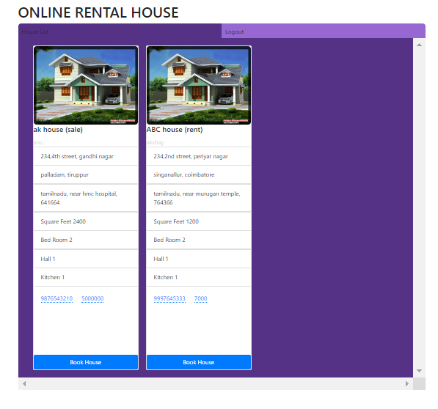

Slide 23
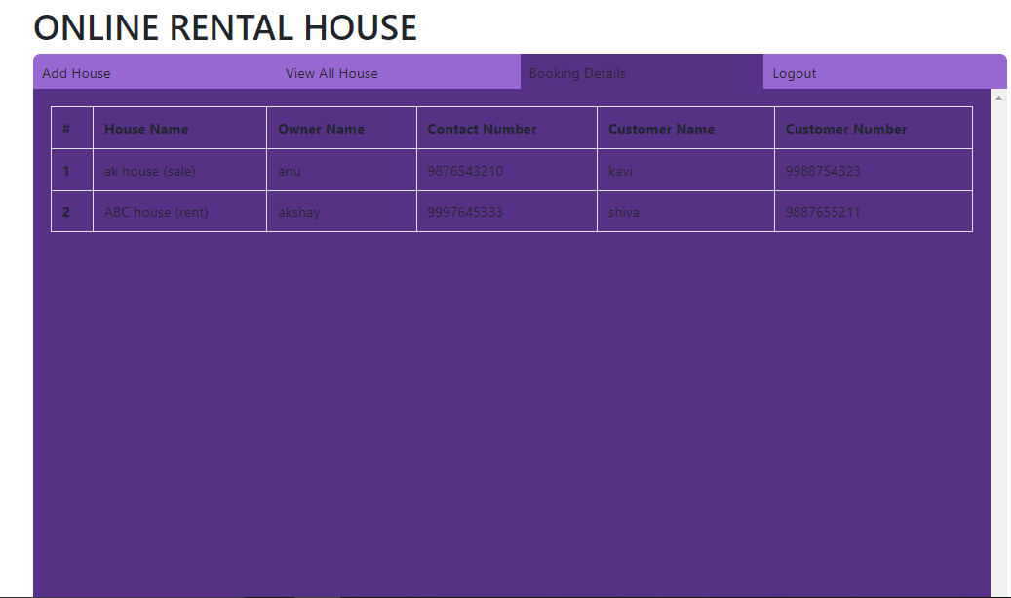

Slide 24
THANK YOU

